Slide 1
Lecture 7.7 Bundling Tasks

Slide 2
Bundling Tasks
How should tasks be bundled together?
Complementary tasks are better performed together
One option is functional grouping of tasks
E.g. manufacturing, sales, finance
Gives rise to the U-form organisation
Benefits: coordination within functional units; develops functional expertise and career paths, economies of scale
Costs: coordination across units: workers focus on their function and ignore other functions

Slide 3
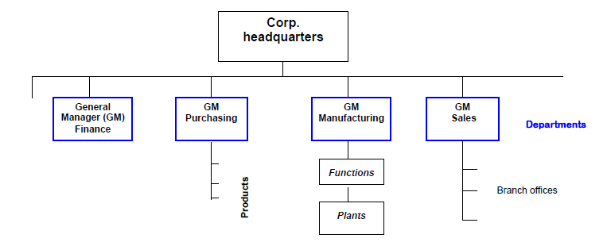
Bundling Tasks
U-form organisation:

Slide 4
Bundling Tasks
Another option is by product or geography:
Gives rise to the M-form organisation
Benefits: decision rights are co-located with specific knowledge; rewards can be based on local performance, improving incentives
Costs: territory disputes; interdependencies might be ignored

Slide 5
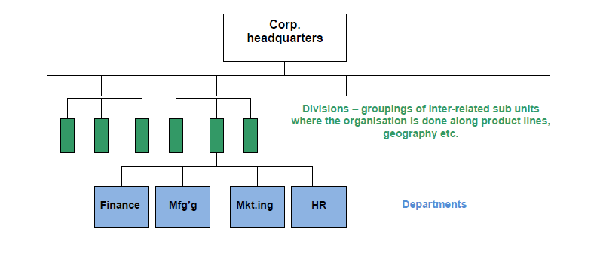
Bundling Tasks
M-form or multi-division organisation:

Slide 6
Bundling Tasks
There are other alternatives
Network organisations
Matrix organisations

